Slide 1
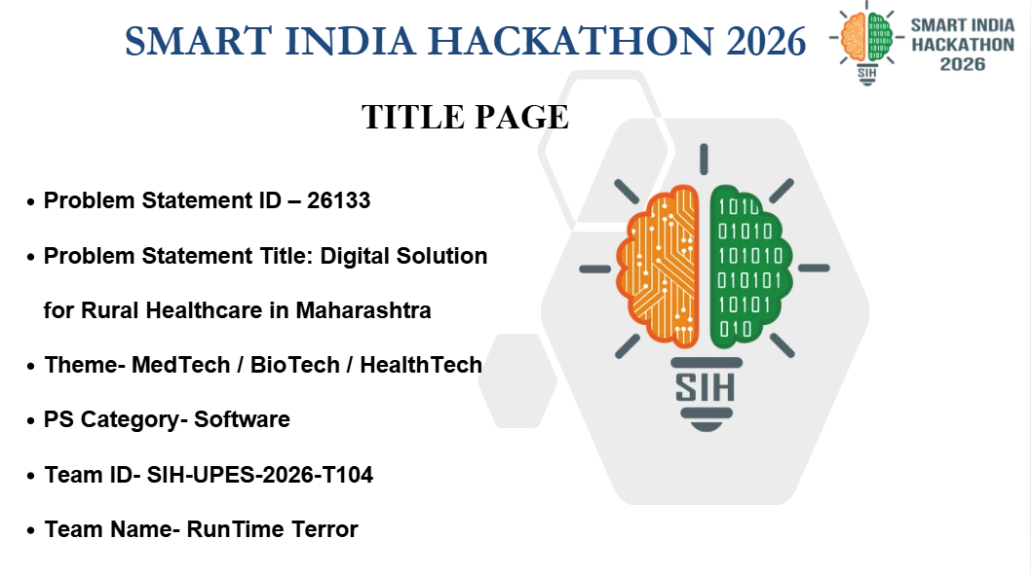

Slide 2

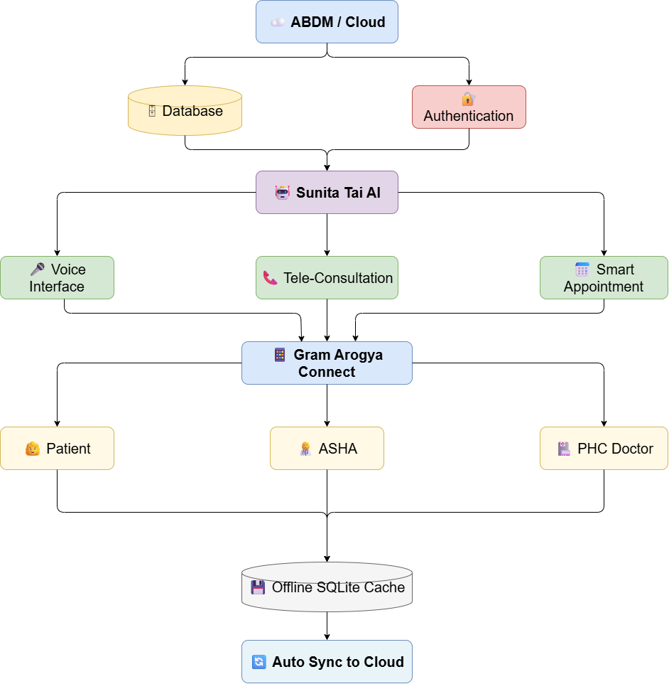
RunTime Terror
GRAM AROGYA CONNECT
PROPOSED SOLUTION
Voice-First Interface Local language interaction
Sunita Tai AI Guide AI-powered healthcare assistance
Instant Teleconsultation Remote doctor consultation
Smart Appointments Booking & live queue tracking
Offline Healthcare Access Works without internet
QR Health Passport ABDM/FHIR-enabled patient journey
.
.
.
.
@SIH Idea submission
2

Slide 3

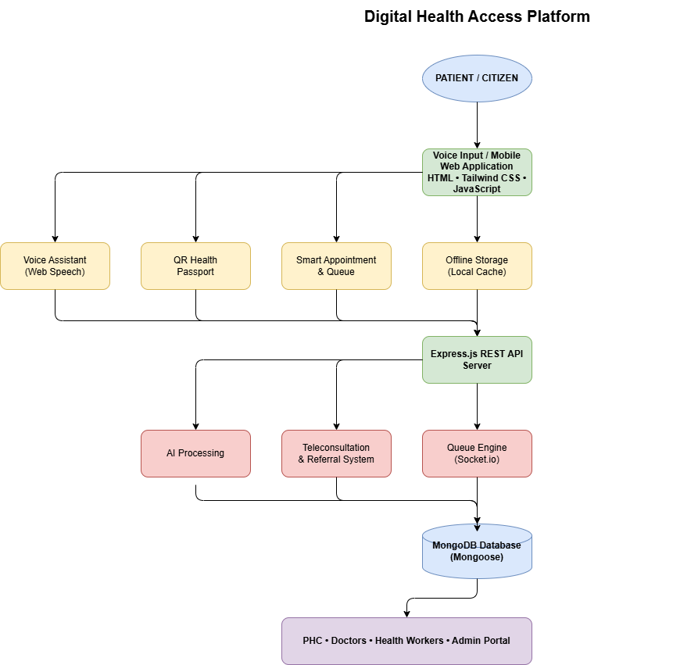
RunTime Terror
TECHNICAL APPROACH
TECHNOLOGIES TO BE USED
• Frontend & Mobile: Cross-platform Web/PWA (Tailwind CSS, HTML5) optimized for low-cost Android phones.
• Voice & AI Engine: Web Speech API for multilingual speech-to-text/TTS; local OCR (Tesseract.js) for ID scanning.
• Data & Interoperability: ABDM API integrations, ABHA ID linkage, HL7 FHIR record schemas.
• Offline Architecture: IndexedDB local caching with automated delta-synchronization.
@SIH Idea submission
3

Slide 4
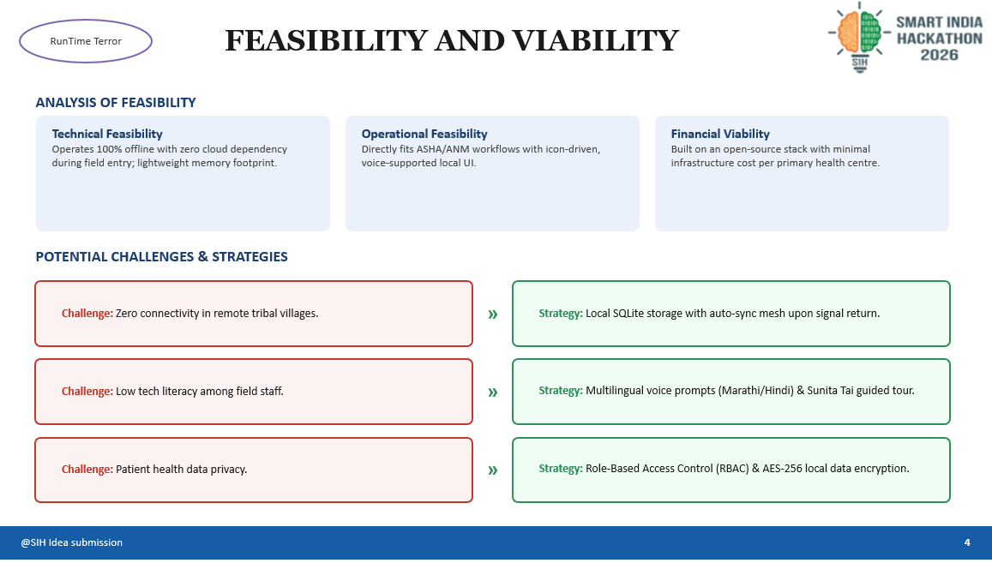

Slide 5
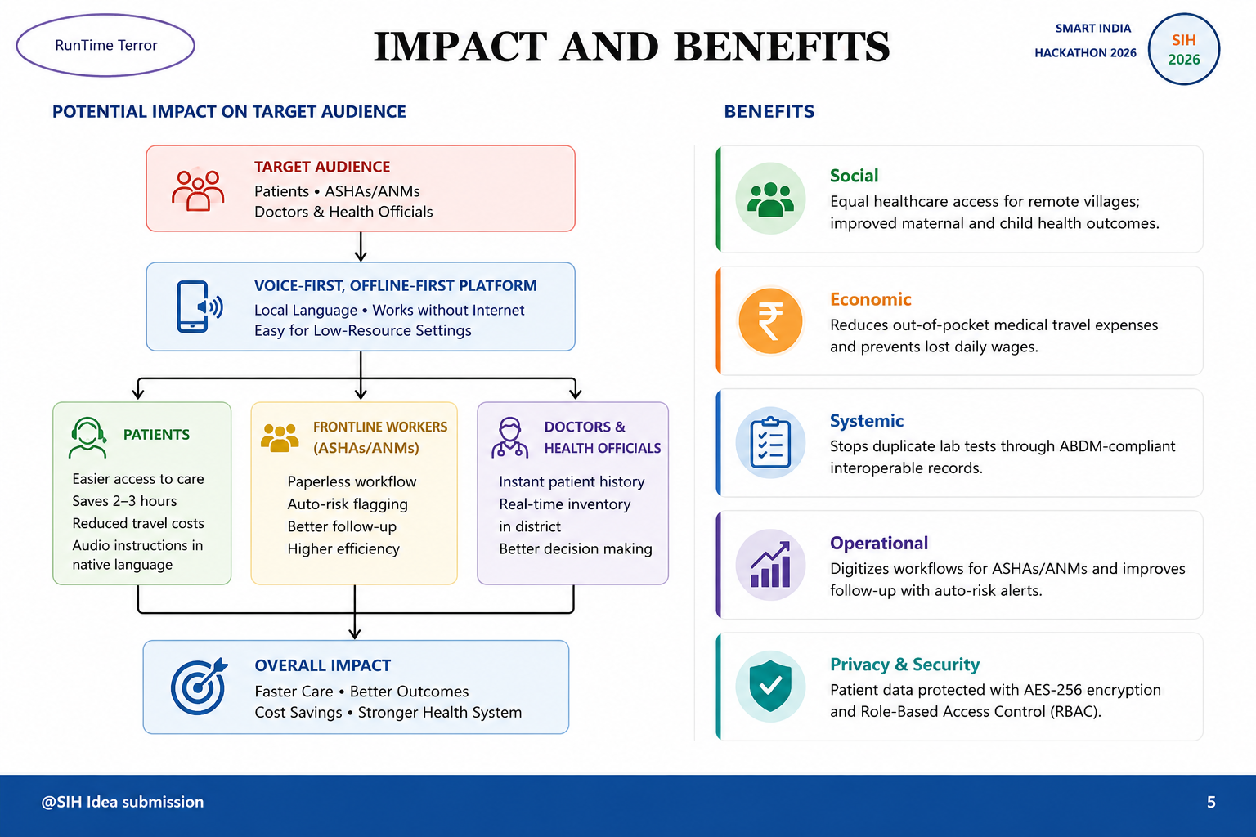

Slide 6
RunTime Terror
RESEARCH AND REFERENCES
SMART INDIA
SIH
2026
HACKATHON 2026
DETAILS / LINKS OF REFERENCE AND RESEARCH WORK
ABDM (Ayushman Bharat Digital Mission) Building Blocks & Health Data Management Guidelines.
1
MoHFW Rural Health Statistics (RHS) Report on PHC Specialist Shortages & Referral Friction.
2
HL7 FHIR (Fast Healthcare Interoperability Resources) Standards for Electronic Health Records.
3
Field research on frontline worker (ASHA/ANM) digital adoption in Maharashtra Sub-Centres.
4
@SIH Idea submission
6

